Slide 1
Unit 203: Electrical installations technology
Data communications

Slide 2
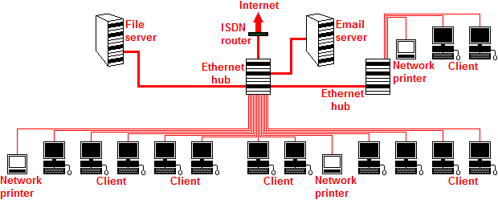
Data communications
Local Area Network (LAN)

Slide 3
Data communications
Cables are categorised according to their maximum operating speeds, as detailed below.
Category 3: supports frequencies up to 16MHz and was commonly used in the 1980s.
Category 4: supports frequencies up to 20MHz but was quickly replaced by category 5.
Category 5: supports frequencies up to 100MHz and is the most common type of cable in use today.
Category 6: supports frequencies up to 250MHz; the augmented category 6 (Cat 6a) reaches speeds of 500MHz and is gaining increased usage.

Slide 4
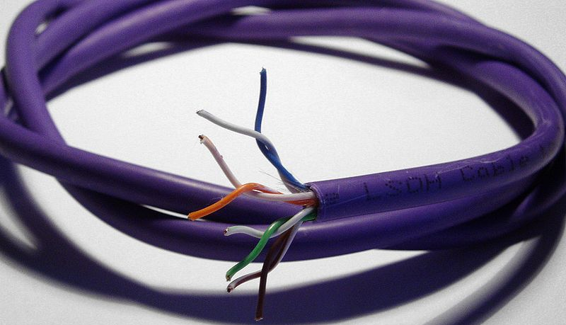
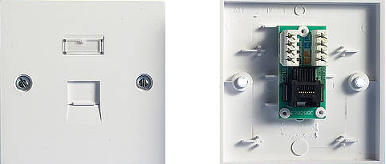
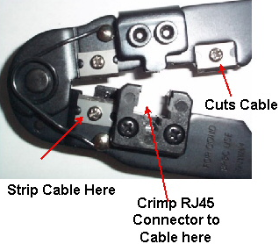
Data communications
Cat 5 cable terminations

Slide 5
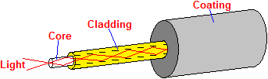
Data communications
Fibre optic cables
Advantages of fibre optic:
very large data transfer rates
no electromagnetic interference
longer lengths of run without the need for repeaters
better data security.
Disadvantages:
high installation cost
complicated installation procedure
possible health risk during installation.

Slide 6
Unit 203: Electrical installations technology
The End

